Slide 1

Case Study Report
Main Topic: Data Center Networks
Flexible, Highly Scalable and Cost-Effective Network Structures for Data Centers
A detailed analysis of a novel network topology designed to meet the demands of modern, rapidly expanding cloud environments.

Slide 2


1. Introduction: The Need for Next-Gen DCNs
Overview and Problem Context
Data Centers (DCs) are the backbone for cloud services, AI, and massive storage systems. Their performance is critically dependent on the underlying network structure connecting thousands of servers.
Traditional designs, such as Fat-Tree or Three-Tier architectures, offer good performance but suffer from high costs and significant expansion difficulties. The paper, “Flexible, Highly Scalable and Cost-Effective Network Structures for Data Centers,” addresses this by proposing a new topology focused on flexibility, easy scalability, and low cost.
Relevance in Today’s Landscape
As giants like Google, Amazon, and Microsoft continuously expand their infrastructure, they require networks that can handle increasing traffic, accommodate more servers, and simultaneously minimize cost and power consumption. A flexible, scalable design is crucial for reducing both equipment and maintenance costs while ensuring high performance and reliability in the cloud-computing era.
Case Study Objectives
Understand flexible and scalable DCN designs.
Analyze the proposed network structure (SDCCP) and its improvements over earlier topologies.
Identify its benefits, challenges, and future potential.

Slide 3
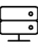


2. Background: DCN Architectures and Metrics
Evaluating Data Center Networks (DCNs) requires understanding the core concepts and the metrics used to measure their effectiveness.
Data Center Network (DCN)
Common Architectures
Evaluation Metrics
A system interconnecting thousands of servers using switches and routers arranged in specific topologies to facilitate high-speed communication.
Three-Tier / Fat-Tree: Hierarchical design.
Scalability (servers supported)
Leaf–Spine: Simplified two-layer, equal-cost paths.
Bisection Bandwidth (throughput)
Cost (switches/links)
Server-Centric (BCube, DCell): Servers also forward traffic.
Energy Consumption
Network Diameter (hop distance)
Summary of Important Research Papers
Paper
Year
Key Idea
Relevance
Yu et al. (SDCCP)
2023
Modular topology using Cartesian-product graphs (SDCCP) for low-cost, incremental expansion.
Core paper of this study.
VL2 (Greenberg et al.)
2009
Flat addressing and load-balancing for enterprise DCs.
Early flexible approach.
HCN/BCN (Guo et al.)
2013
Server-centric, cost-efficient designs with good expansion properties.
Comparison for cost and scalability.

Slide 4
3. Problem Statement
Existing data center network architectures are struggling to keep pace with the exponential growth of cloud and AI workloads. The primary issues revolve around inflexibility and escalating operational costs.
Expansion Difficulty
High Infrastructure Cost
Energy Inefficiency
Traditional networks are difficult to expand incrementally, often requiring a complete redesign or significant downtime, which is impractical for large-scale operations.
The high number of specialized switches and extensive cabling required in topologies like Fat-Tree significantly increases deployment costs.
Many network links remain under-utilized, leading to wasted energy. Furthermore, the power and cooling requirements for large, dense networks rise rapidly with scale.
The fundamental challenge is: How can we design a data-center network that remains flexible, scalable, and cost-effective while still providing high performance?
This problem is significant because rigid architectures cannot adapt to rapid changes in traffic patterns or hardware upgrades, hindering the growth and profitability of cloud service providers.

Slide 5
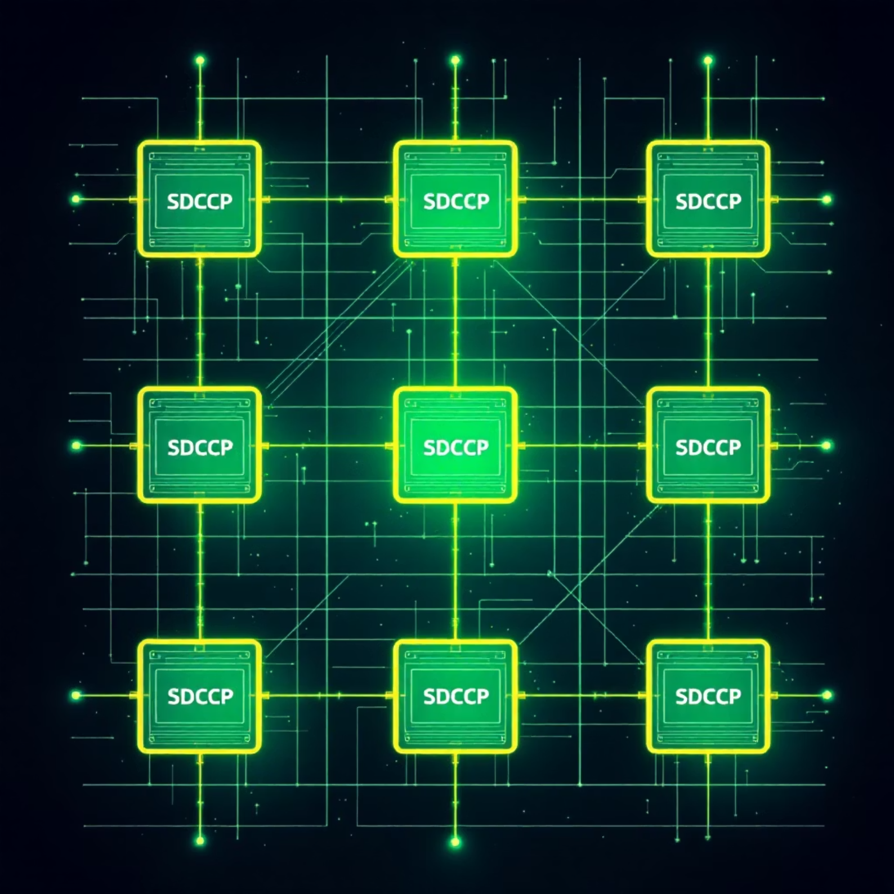
4. Analysis: The SDCCP Solution
4.1 Approach: Modular Design via Cartesian Product
The authors propose SDCCP (Scalable Data-Center network based on Cartesian Product). This topology
is mathematically constructed using the Cartesian product of smaller graph units, resulting in a
highly modular and regular structure.
Modularity: Each module connects servers and switches using common, low-cost m-port commodity
switches and 2-port servers.
Incremental Scaling: New modules can be attached without replacing existing infrastructure, making
expansion flexible and significantly cheaper.
Evaluation: SDCCP was compared against Fat-Tree and BCube using simulation and analytical models across key metrics like cost, bisection bandwidth, power consumption, and path length.
4.2 Key Findings: SDCCP Outperforms Competitors
30%
Cost Reduction
SDCCP reduces network cost by approximately 30% compared to Fat-Tree and 60% compared to BCube.
27%
Energy Savings
Energy consumption drops by about 27–35% due to optimized link utilization and fewer components.
100%
Scalability & Flexibility
Offers excellent, incremental scalability, avoiding complete rewiring, and maintaining short path lengths (low average hop count).
Figure 2: Simplified SDCCP Structure illustrating modular connectivity.

Slide 6
4.3 Discussion
Strengths:
Uses cheap, off-the-shelf switches.
Modular design allows smooth growth.
Lower energy consumption and operational cost.
Balanced load and fewer bottlenecks.
Limitations:
The study used simulations; real-world implementation may show different behavior.
Expansion planning still requires coordination among modules.
Routing algorithms for very large scales might become complex.
Comparison with Other Architectures:
Fat-Tree gives predictable performance but poor flexibility.
BCube is server-centric and power-hungry.
S2 and VL2 provide flexibility but may cost more in high-port switches.
SDCCP achieves a good compromise between performance, cost, and expandability.

Slide 7
5. Conclusion and Future Directions
5.1 Key Takeaways
Cost-Efficiency
Flexibility & Scalability
Practicality
SDCCP successfully lowers both deployment cost and energy consumption compared to traditional topologies.
Provides a highly flexible and scalable structure for modern data centers using simple, commodity hardware.
The concept of incremental expansion is highly practical and necessary for rapidly growing cloud environments.
5.2 Future Directions for Research
To fully realize the potential of SDCCP, future work should focus on:
Applying machine-learning-based traffic prediction to optimize expansion and routing decisions.
Exploring hybrid optical or wireless links to enable faster network reconfiguration.
Testing SDCCP in real-world deployments to study latency, congestion, and fault recovery under operational conditions.
Developing energy-aware routing protocols to further reduce power usage.
References
Yu, Z., & colleagues. (2023). Flexible, highly scalable and cost-effective network structures for data centers. Journal of Network and Computer Applications, 224, 103675. https://doi.org/10.1016/j.jnca.2023.103675
Greenberg, A., et al. (2009). VL2: A Scalable and Flexible Data Center Network. ACM SIGCOMM.
Guo, D., et al. (2013). Expandable and Cost-Effective Network Structures for Data Centers (HCN, BCN). IEEE Transactions on Computers, 62(7).
Sharma, M., & Singh, P. (2020). A Survey on Data Center Network Architectures. International Journal of Computer Networks, 12(4), 45–54

